Slide 1
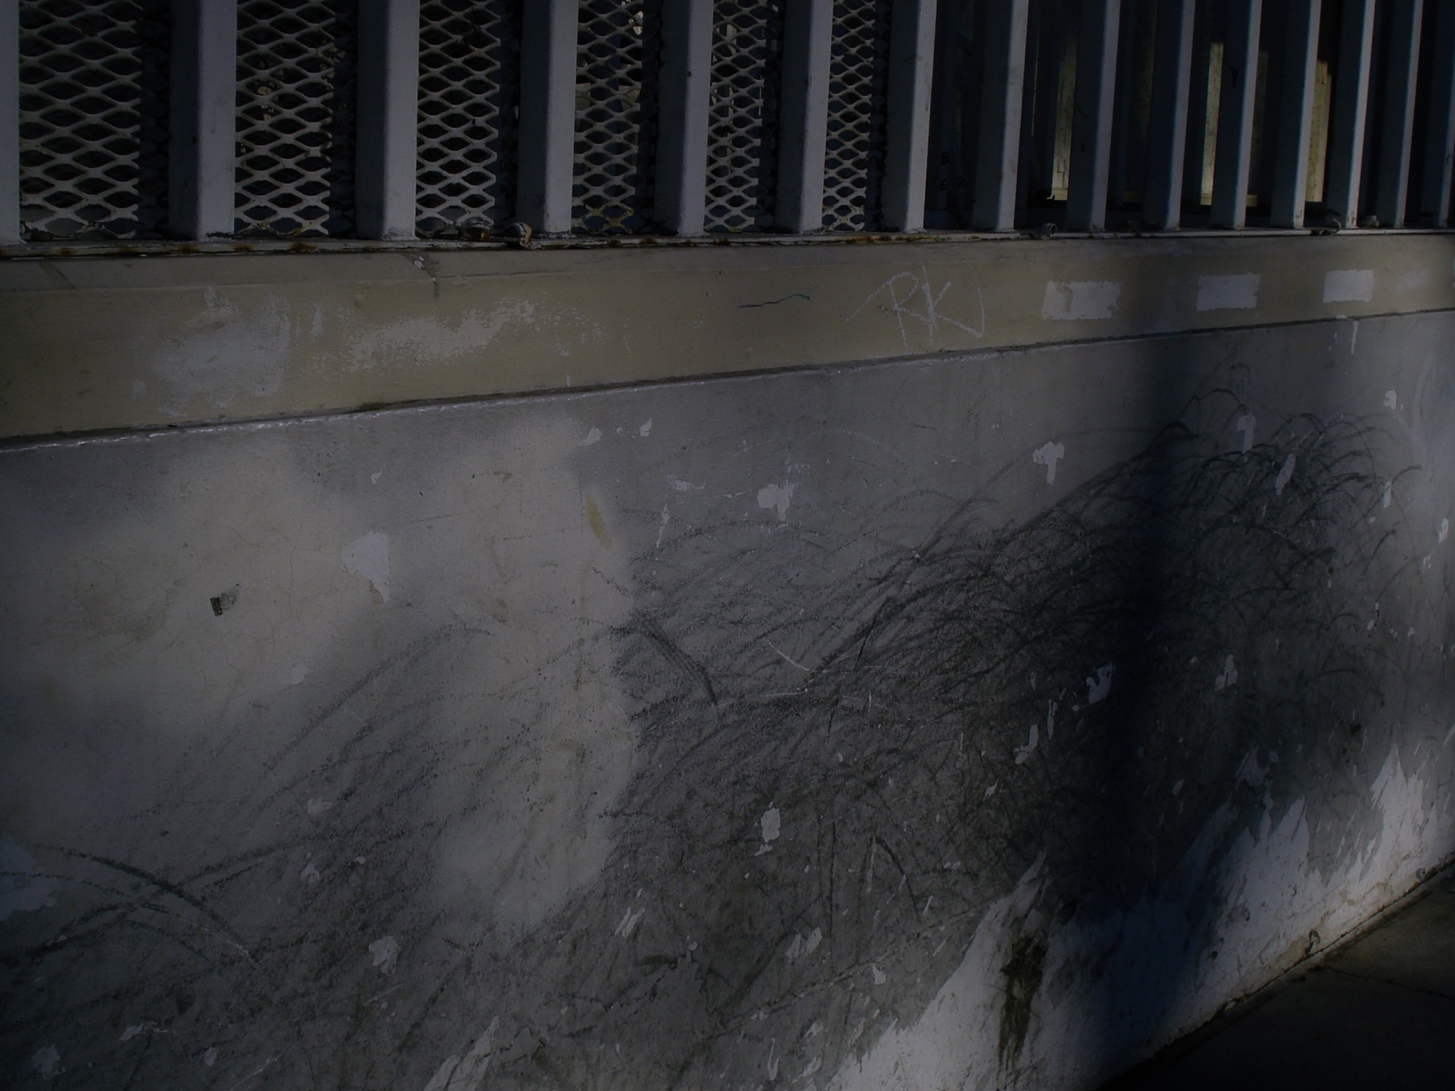

UNDERBRIDGE design

Slide 2

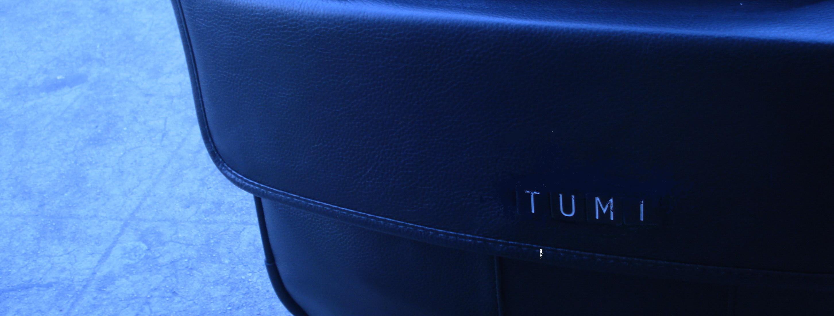

Leather Laptop 250

Slide 3
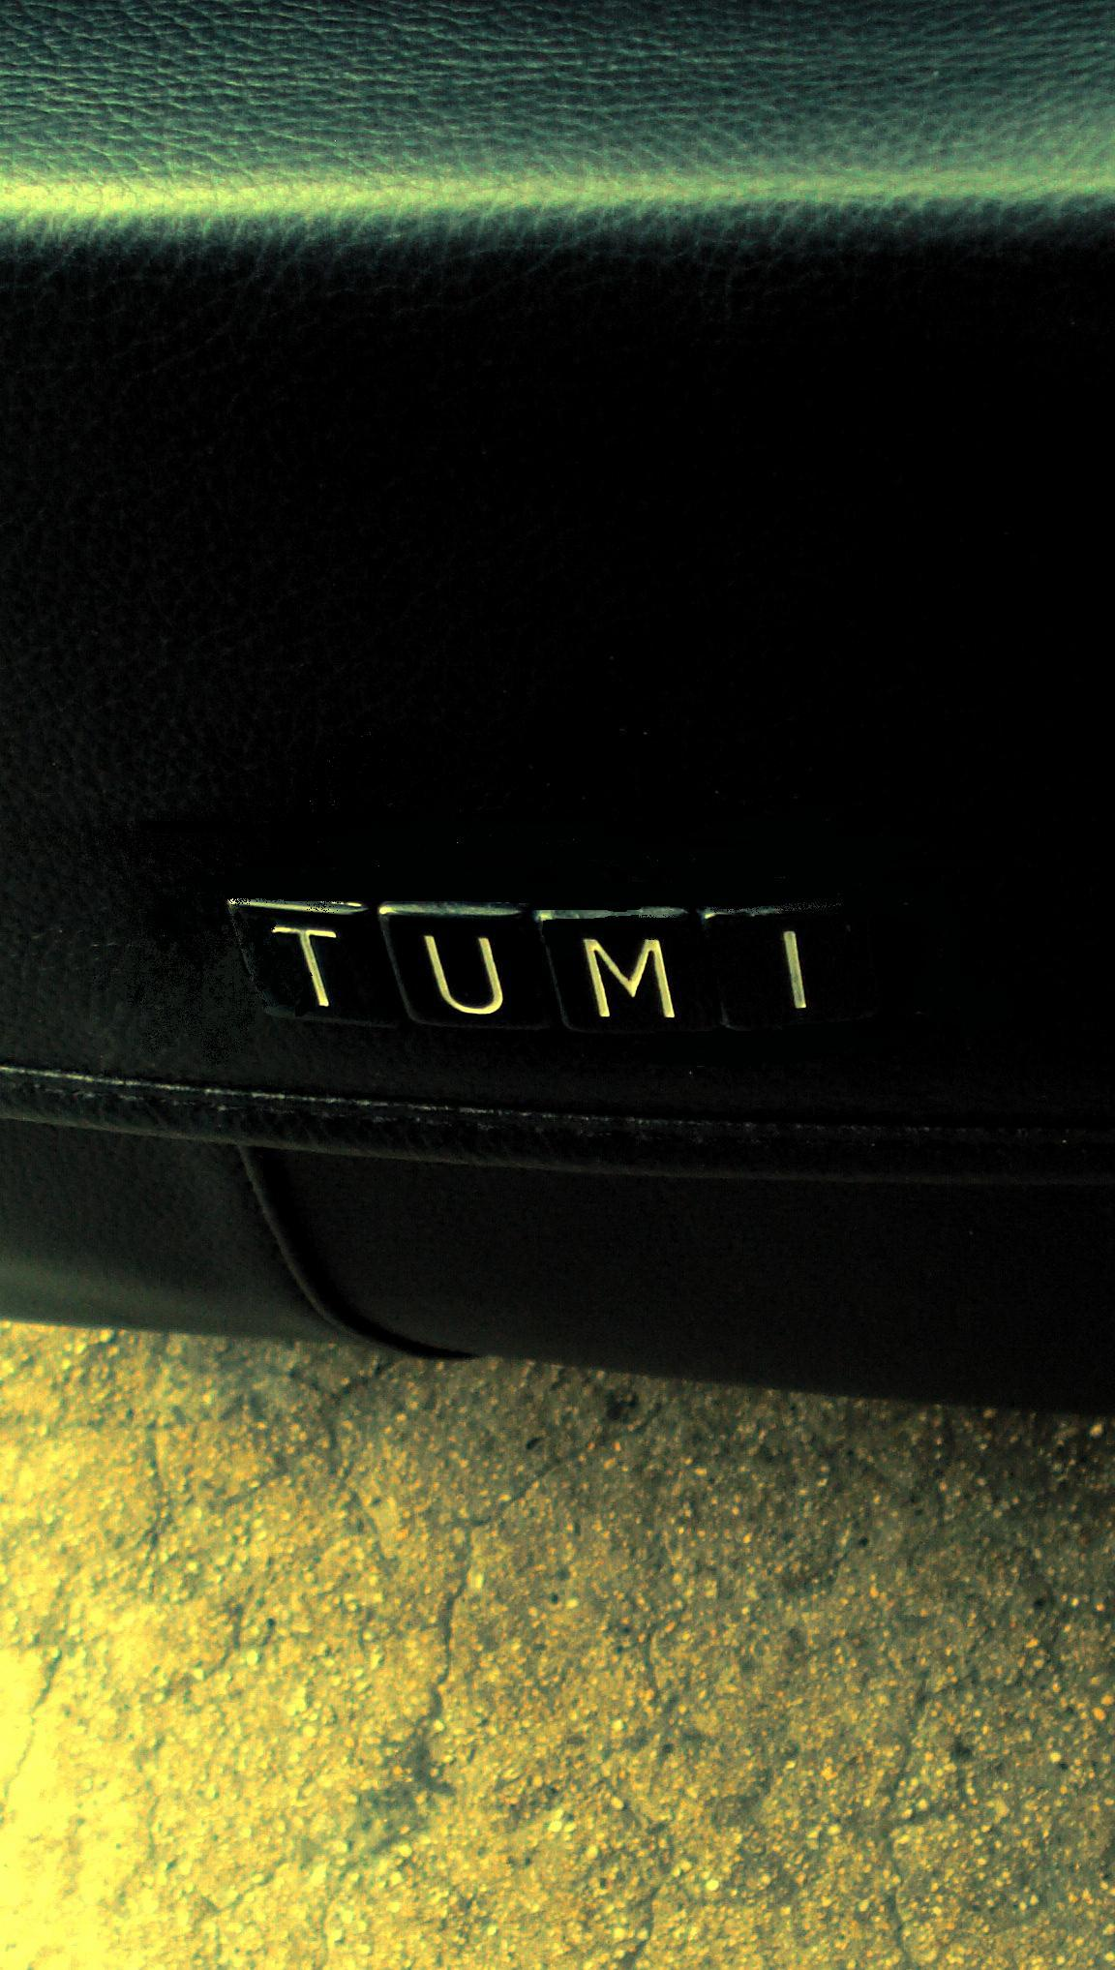

Leather shaving kit 100

Slide 4
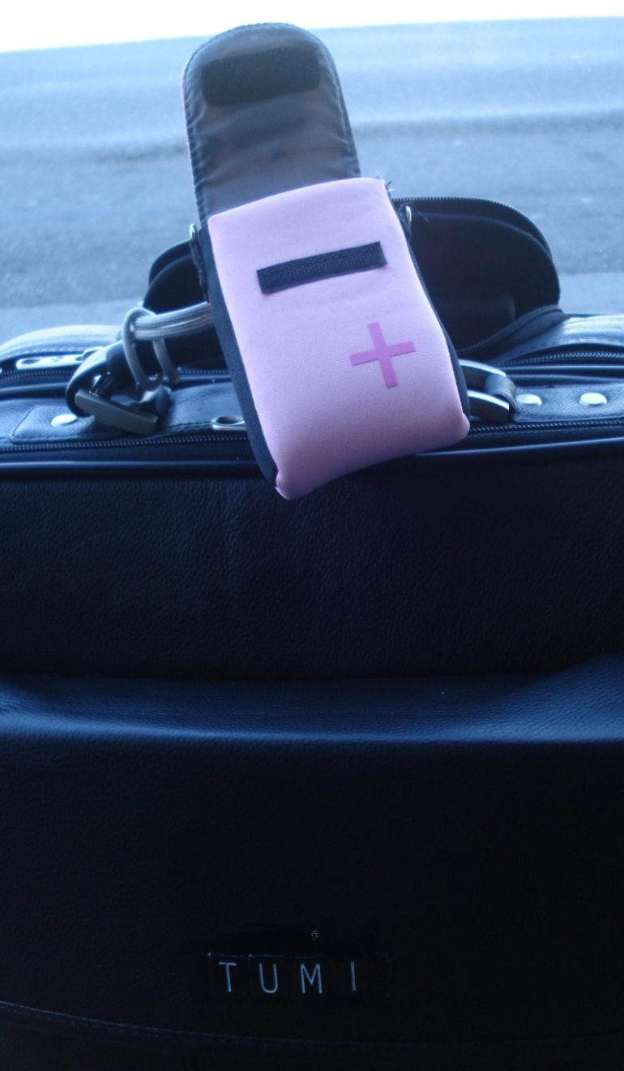
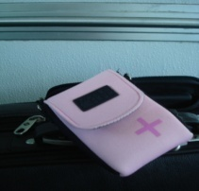

Camera pouch 60

Slide 5
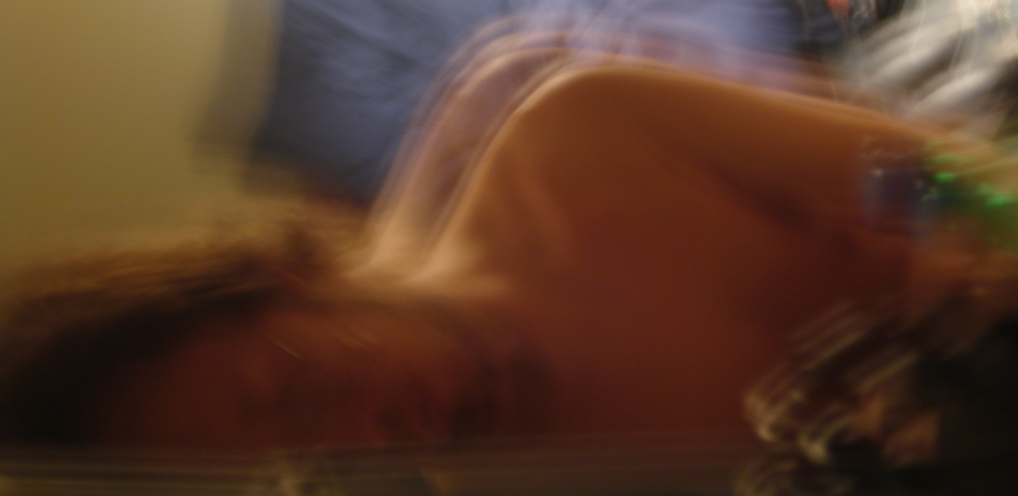



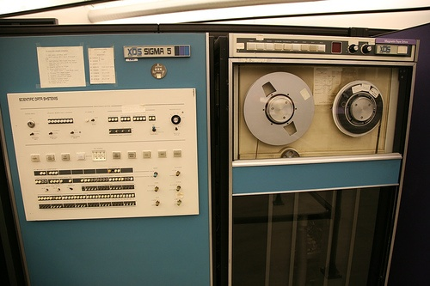
D J teknician
Pick-up DJ Teknician’s new album ‘techrise’ on Ravetrax Records November 6
WEDNESDAY’S @ FUBAR WEST HOLLYWOOD

Slide 6
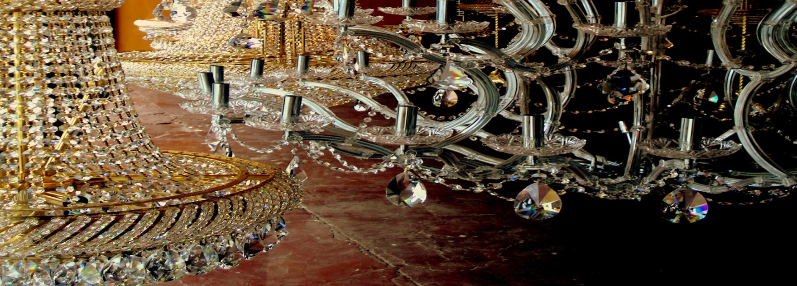
G
Your invited……

Slide 7
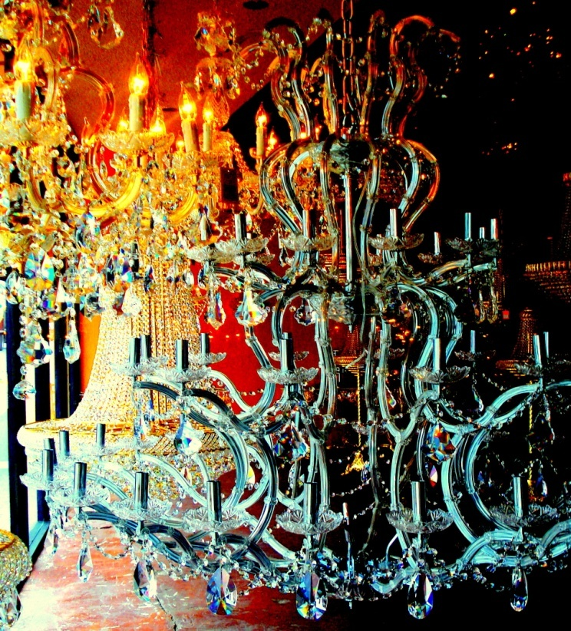
Tim and Joanna's
Annual Dinner Theatre
G
Thursday August 14th 2008 5:00 pm dinner will be served

Slide 8
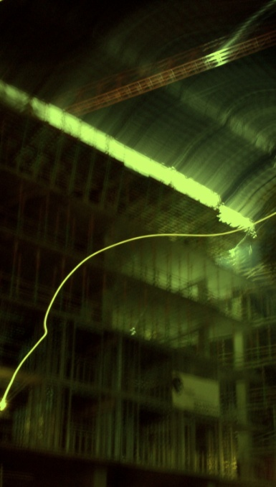
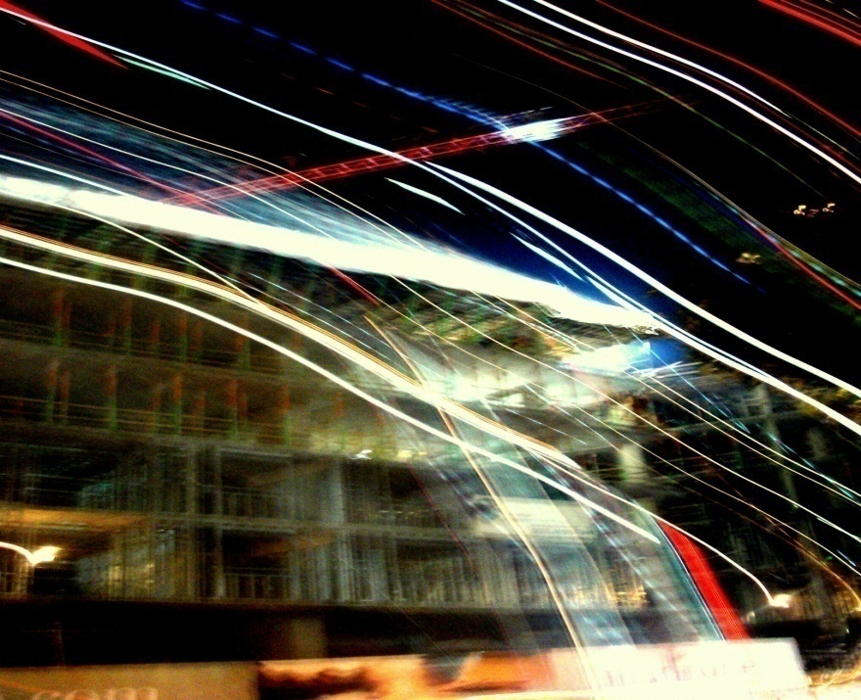
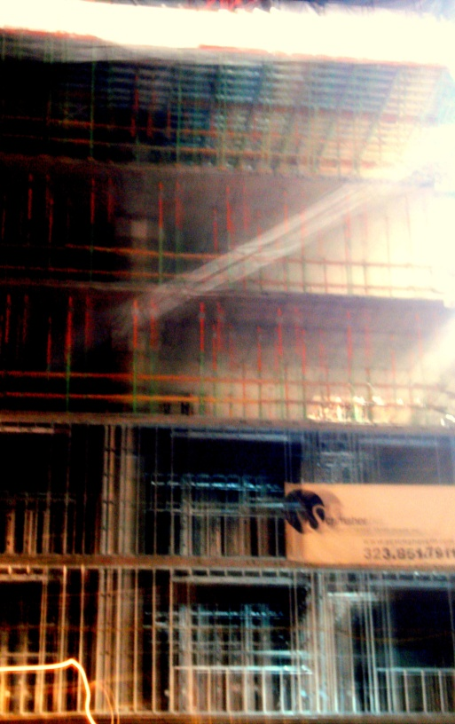

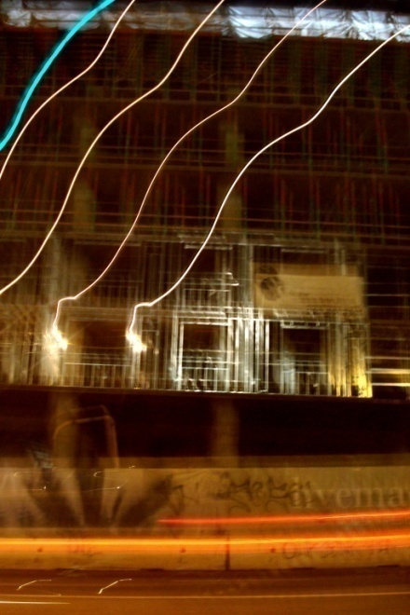
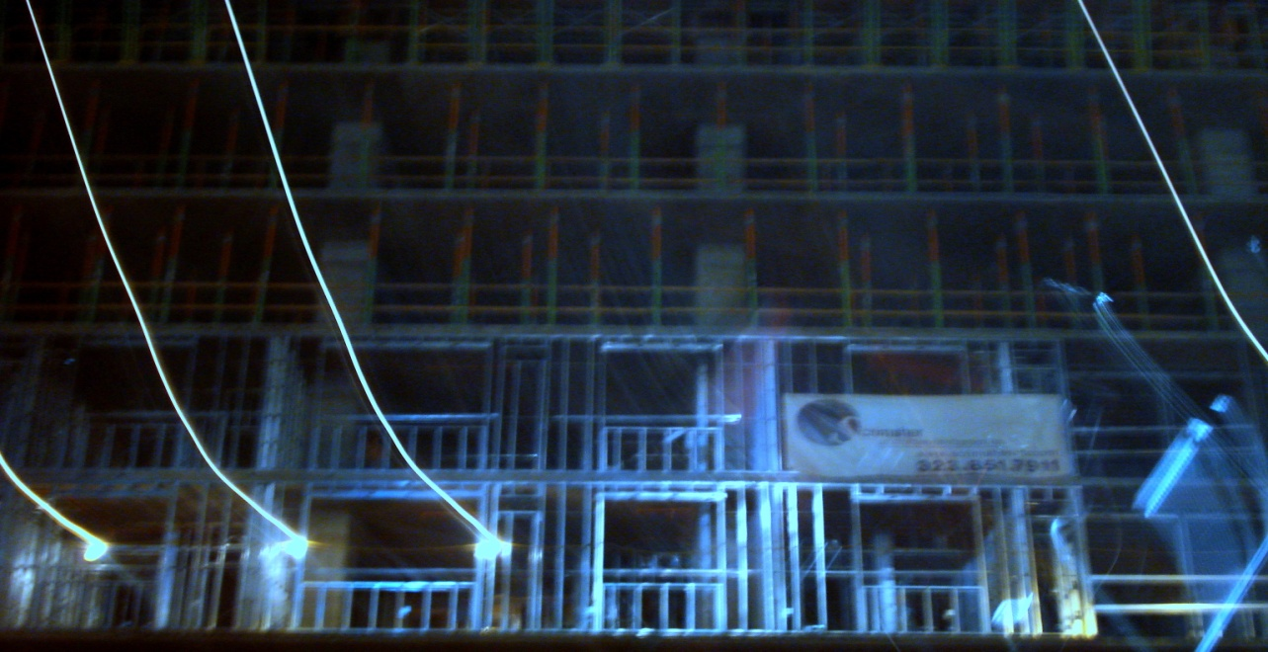
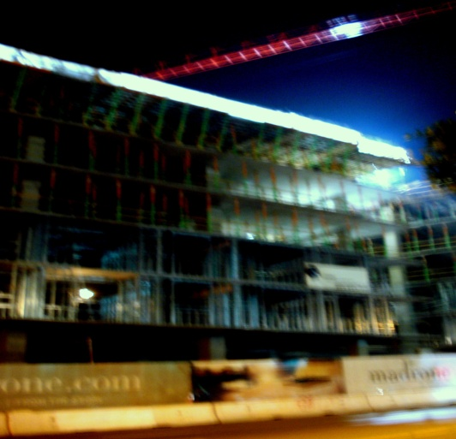
EU RAIL is running and on schedule
during current construction.
EURAIL MANAGEMENT

Slide 9


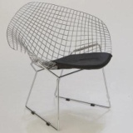
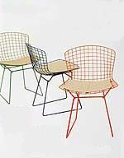


Slide 10

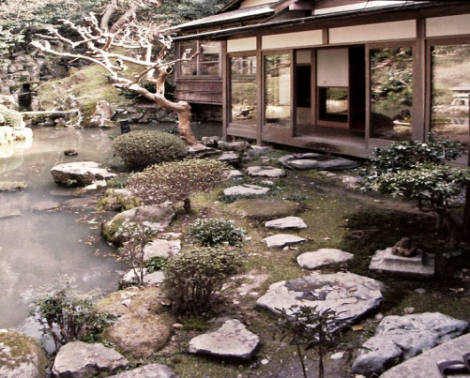
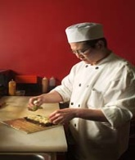
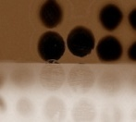
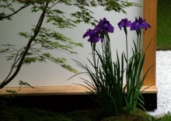
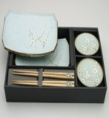
Sushi
Meeshi
OUR CHEFS
DINING ROOM
OUR MENU
1414 South Johns Blvd. South Philly
792.656.8746

Slide 11



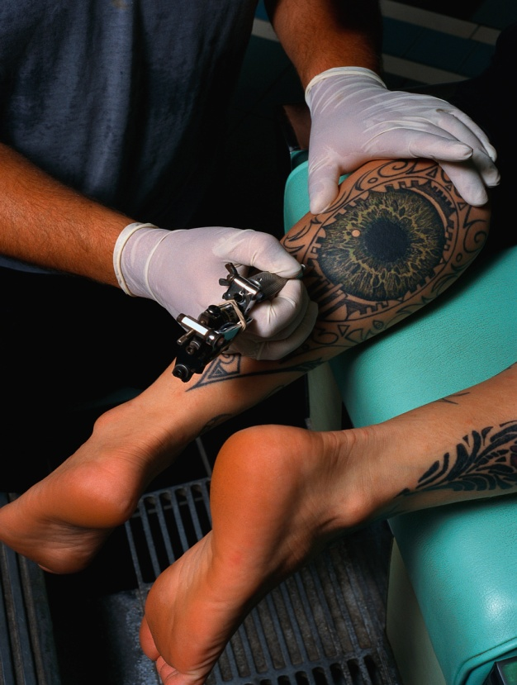

Ugly
Dawg
venice
Tattoos
UDT BIZ CARD
Ugly
Dawg
Grand opening this Thursday January 14 2008
Opening night party Thurs 9pm-3am
UDT PARTY MAILER
Tattoos
UDT
venice
MANAGEMENT

Slide 12
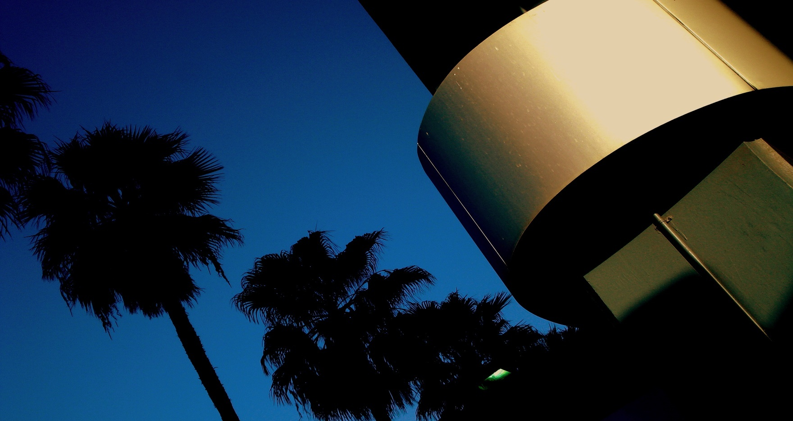


CALABASAS
2008
2007
CONTACT US
SCHEDULE A TEST DRIVE

Slide 13
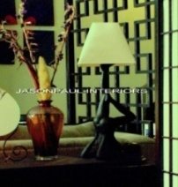
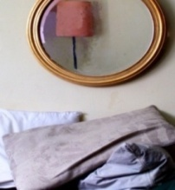
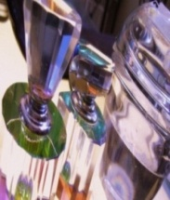
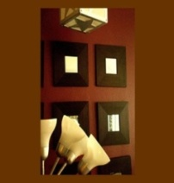
JASON ADLER DESIGN
FALL 2008
HOME COLLECTION

Slide 14
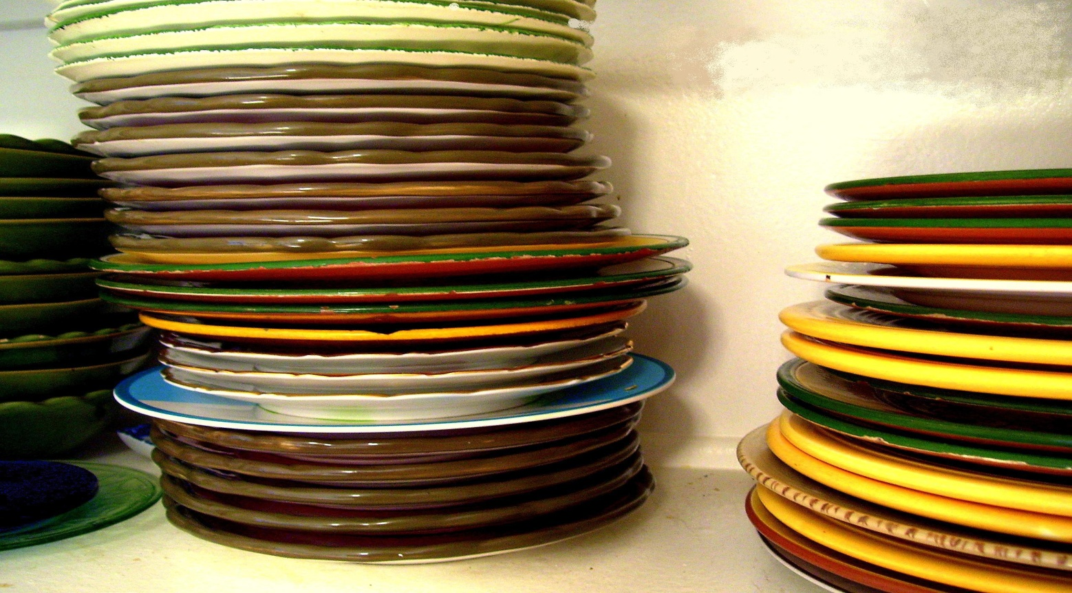
Dishes for your lazy summer afternoons in five summer colors. These bright, and cheerful Italian Ceramic plates, saucers and mugs wont fade over time and are dishwasher safe. The light weight and thick bodies make them extremely durable ..for you to enjoy for years to come. Mix or match colors to add a unique flare to your BBQ. Only available this summer… and only available at your summer party headquarters…
POTTERYBARN.COM

Slide 15
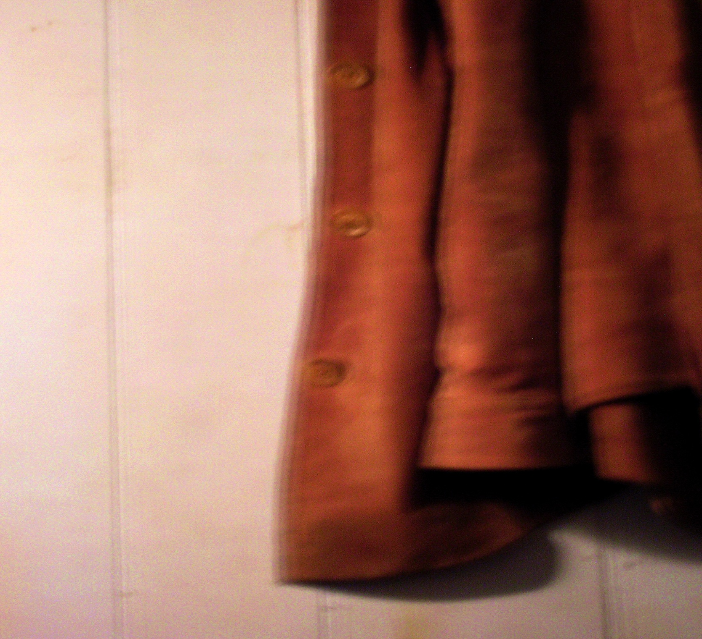

SUEDE
BANANA REPUBLIC

Slide 16

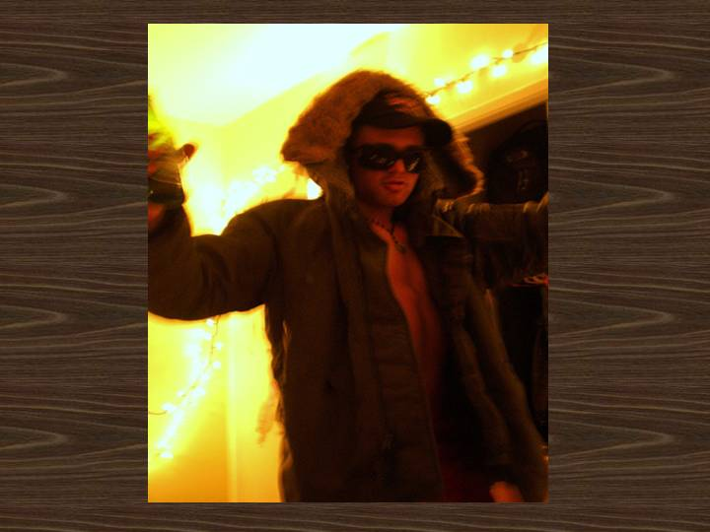

VoLcom

Slide 17


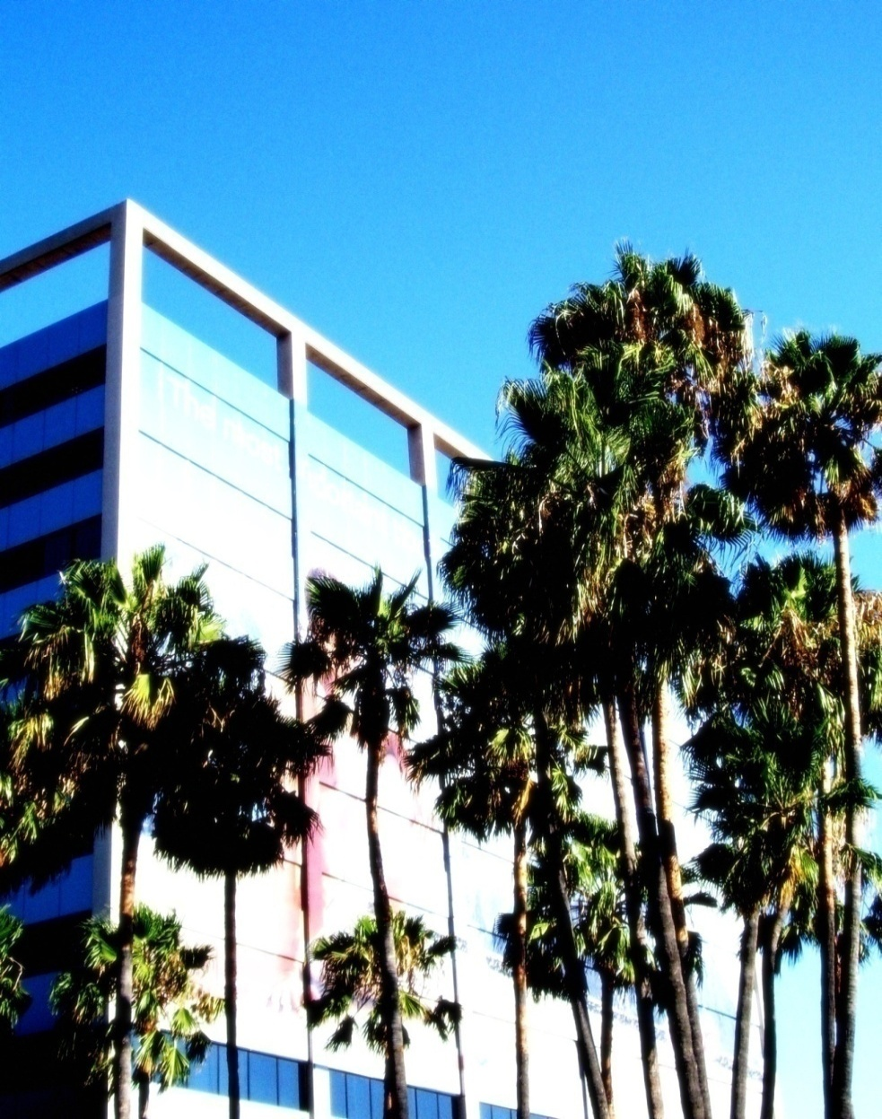
CALIFORNIA
STATE OF
FOR OFFICIAL TRANSCRIPT OF MEETINGS HELD BY THE ASSEMBLY WRITE
TRANSCRIPTS
1498 BLANKLY AVE. SACRAMENTO, CA 98765
ASSEMBLY
MEETING NOTES MAY 23, 2007

Slide 18

Metro.net

Slide 19
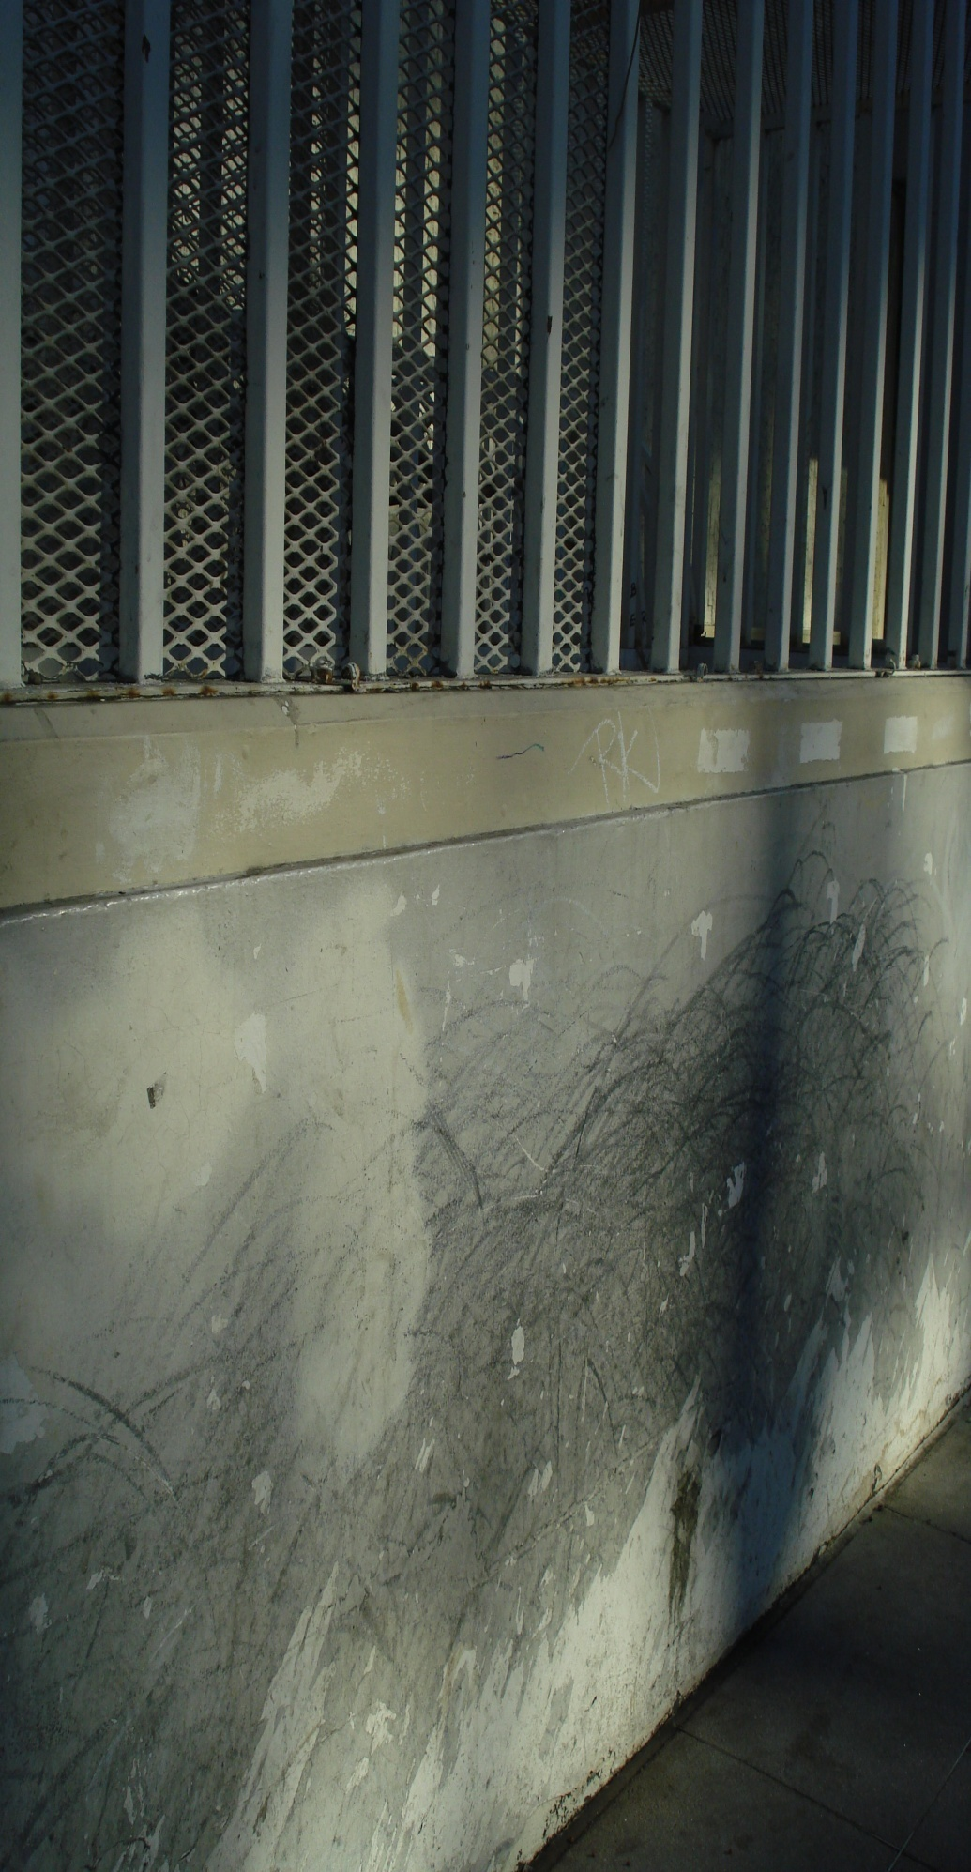

JOB MATERIALS
CLIENT
At the completion of each job the client is supplied with a logo and graphics treatment sheet, the completed job and all its backed-up elements on a zip drive or software of the clients choice. Print ready or web ready data as requested. Additionally, all work will be stored by Underbridge design if requested free of charge for one years time.
UNDERBRIDGE design

Slide 20


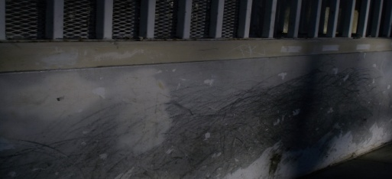



UNDERBRIDGE DESIGN LOGO SHEET (LOGO, BUSINESS CARD, LETTER HEAD, FAX HEAD, ENVELOPE)
UNDERBRIDGE design
Font: cordia new
text : RGB W 242, 242,242 BLK 3,3,3
RGB 236,241,31
RGB 194, 194, 194
RGB 12,12,12
UNDERBRIDGE design
UB design
0NE ELM STREET
VENICE CA 90210
S
underbridgedesign.com 310.666.6666
UNDERBRIDGE design
ONE ELM STREET VENICE CA 90210
underbridgedesign.com 310.666.6666
ONE ELM STREET VENICE CA 90210
underbridgedesign.com PH 310.666.6666 PH 310.666.6666
UNDERBRIDGE design

Slide 21
CONTACT
CLIENT
MARK SUMMERS
UNDERBRIDGE DESIGN
1366 ROSE AVE, VENICE CA 90291
310-614-7385
UNDERBRIDGE design

